Slide 1
EMERALD TIMES
LIVE, MERRY, PARTY & BLOOM
2023-2024

Slide 2
PREVIEW
Orientation & Intro
Activity Update in tenure
Enagagement plans ahead
Key aspects to focus :-
Good living standards Vs Minimalism
Good Housekeeping
Health
Fitness & Diet
Grooming of Ownself & Kids
Fin Awareness
Org Awareness
Grooming Aspects :-
Study plans & techniques
Career Counselling & Plans
Competetive exams
Routine & habit building
Pursuasion & perspectives
Cultural Values & Foundations
Global outlook & street smartness with Presentation Skills
Wellness Aspects :-
Health glorification
Wealth building / Participation
Mutual alignment towards Life’s goals
Grooming to attain rightful balance
Better Homemaking
Empowerment & Skill Building

Slide 3
SCHEDULE
2023 | JAN | FEB | MAR | APR | MAY | JUN
 | Orientation & Acads of Kids |  | Holidaying | Career Counselling | Skill Courses | Health & Fitness
 | JUL | AUG | SEP | OCT | NOV | DEC
 | Diet | Workouts | Pers Finances | Cooking | Activites | Touring
2024 | JAN | FEB | MAR | APR | MAY | JUN
 | Grooming | Skill Building | Habit building | Extra Curriculars | Online Applications | Travels Abroad
 | JUL | AUG | SEP | OCT | NOV | DEC
 | Health Checkups | Domestic Issues | Relations | Activity Trackers | Household Mgt | Global outlook

Slide 4
HEALTH : VITALS FOR HUMAN BODY
NUTRIENTS
MACRO NUTRIENTS (Gives Energy) |  |  | MICRO NUTRIENTS (Does not give Energy)
Proteins | Carbo – hydrates | Fats | Vitamins | Minerals | Fiber | Anti- Oxidants | Phytochemicals

Slide 5
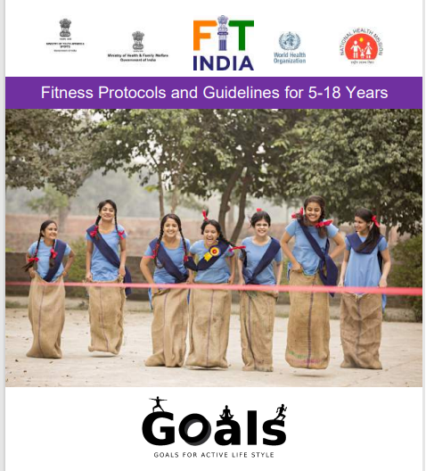
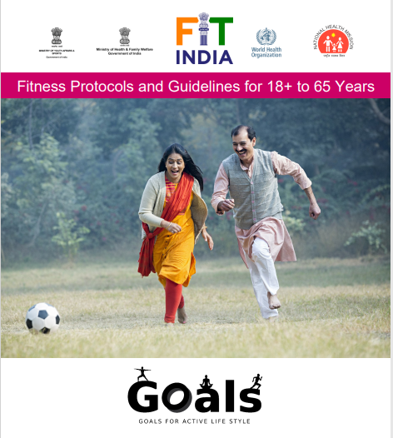
FITNESS

Slide 6
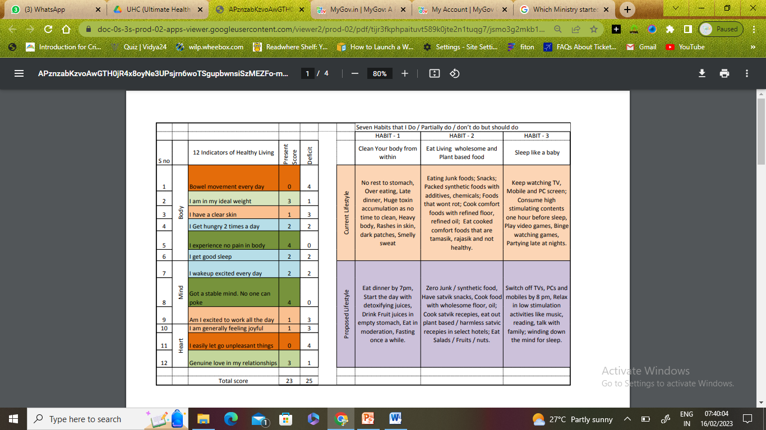
HABITS

Slide 7
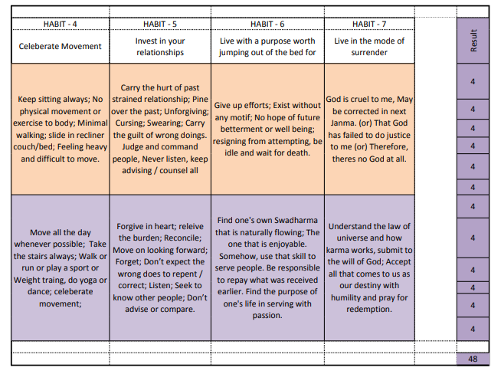
HABITS

Slide 8
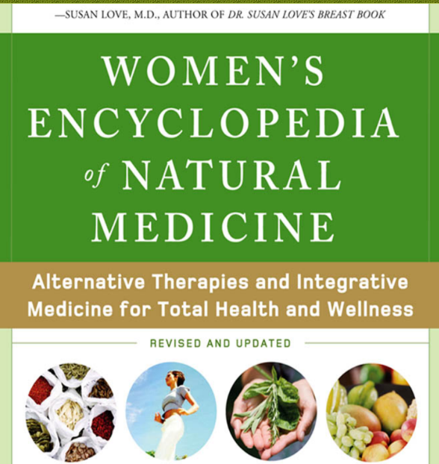
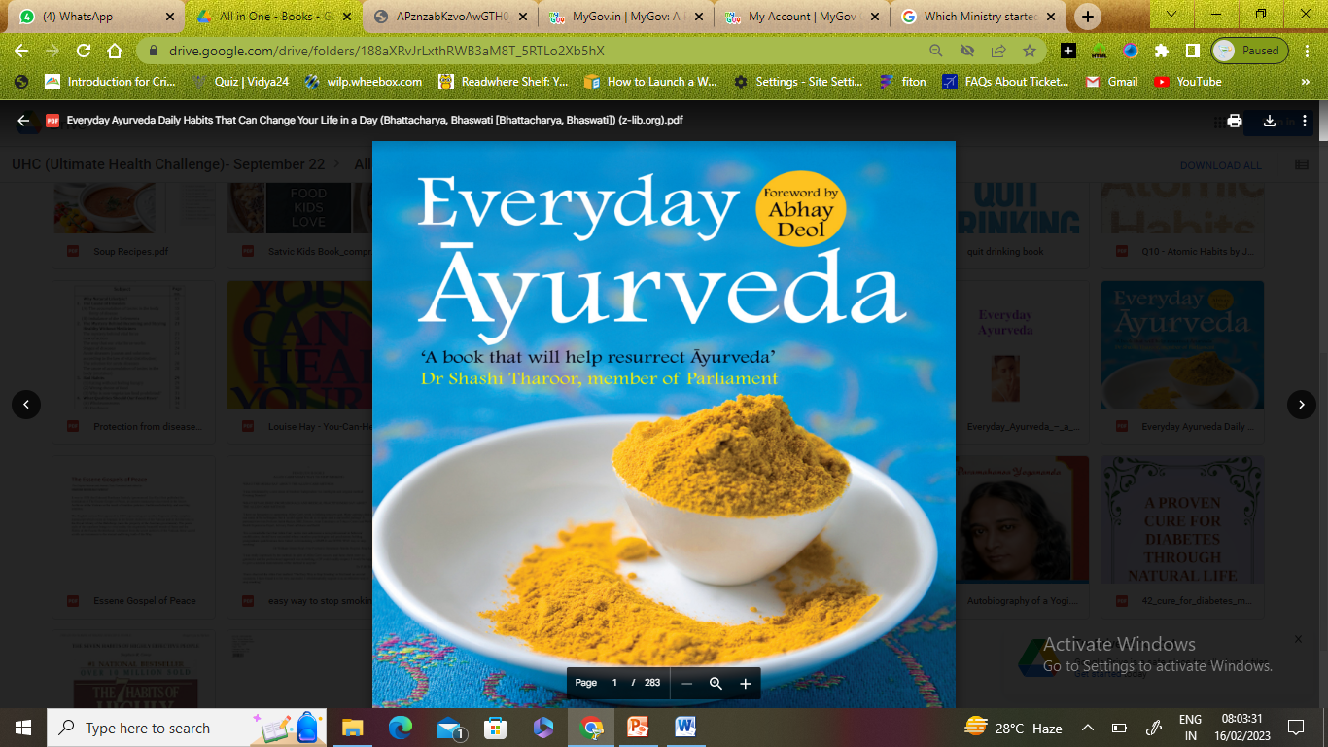
REFERENCE BOOKS

Slide 9

CERTIFICATIONS & OUTLOOK
https://www.mygov.in/

Slide 10

PARTNERSHIP

Slide 11
NOURISH & CHERISH
https://github.com/swpb2023

